Slide 1
World War II
Activities

Slide 2
Yalta and Poland – Part 1
The Principle of the Atlantic Charter.
Guidelines for a provisional government.
Agreement regarding Japan.
Notes:
The leaders at Yalta swore to uphold the principle of freedom and interests of affected countries under the Atlantic charter. The guidelines for a provisional government stipulated that governance should be democratic and elections be done using secret ballots as well as development of universal suffrage. The three powers agreed to restore the status quo of the Mongolian state, the initial right of Russia, and give Kurile Islands back to the USSR.

Slide 3
Part 2
False hopes of democratic elections and liberated countries.
Soviet’s intervention in the war with Japan and its outcomes.
Notes:
The concepts of democracy and liberation remained false hopes since the West were using Poland as a ‘litmus paper’ to exercise its intentions against the USSR. The Soviets intervened in the Japanese War to restore the status quo for the Mongolian state, regain its right after the Japanese attack in 1904, and get the Kurile Island back.

Slide 4
Part 3
Roosevelt’s physical condition based on the ‘Image of the Big Three.’
Response to Roosevelt’s advisor’s claim about Poland.
Roosevelt’s primary concerns.
Roosevelt’s reaction to the questions.
Notes:
Roosevelt is physically-emaciated and exhausted at the Yalta. He is the best option for a president despite his condition. I agree that Poland symbolized America’s ability to iron her issue with the USSR since it was a testing ground for American ideas. Roosevelt’s primary concerns according to the American diplomat were USSR’s settlement in Tehran and the division of Germany. Lastly, Roosevelt was concerned about the Soviet’s influence in Poland that was a hindrance to democracy.

Slide 5
Analyzing Motives
Britain | Germany
To undermine Germany by ensuring that the Treaty of Versailles and the Anglo-German Naval agreement are upheld. | To break away from the Treaty of Versailles that had put sanctions on Germany; for example, it expected her to pay war reparations.
To prevent Germany from taking over the Rhineland. | To regain Austria as well as Sudetenland, Czechoslovakia and Poland.
To convince the USSR to adopt the policy of appeasement (Pearson Global Schools, n. d). | To limit Western influence on nations in Eastern Europe.
To establish its influence in Poland (BBC, n. d). | To show its military power based on its huge army and lethal weapons (Digital History, n. d).

Slide 6
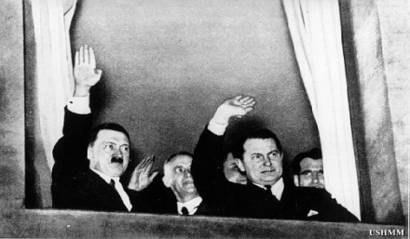
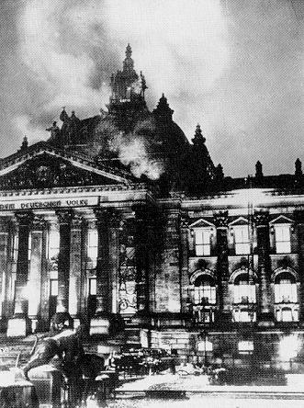
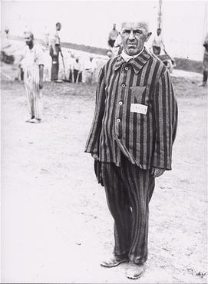
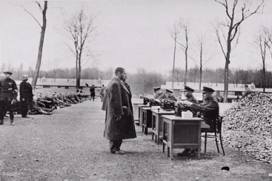
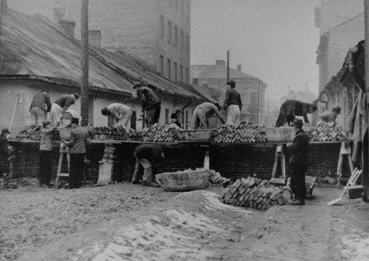
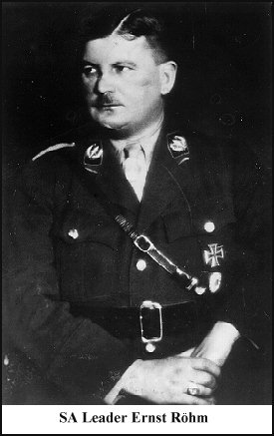
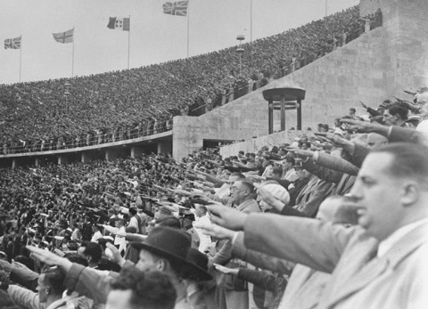
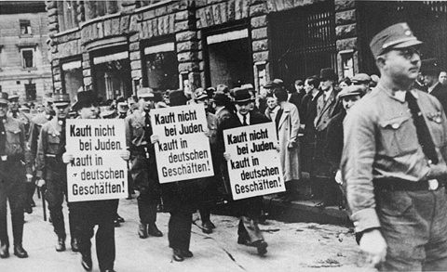
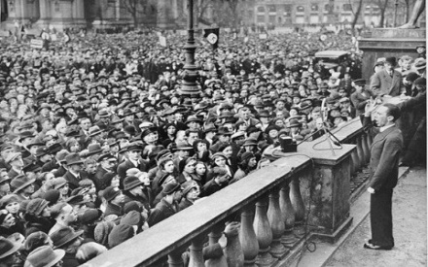
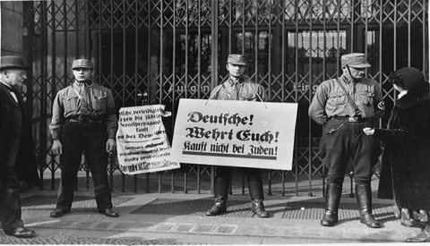
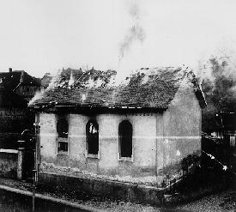
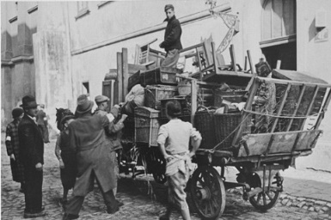
Memories of the Holocaust
a
Notes:
1. On the night of January 30, 1933, the Nazis organized a massive torchlight parade in Berlin to celebrate the appointment of Hitler as Chancellor of Germany.
2. The Reichstag building, seat of the German government, burns after being set on fire by Nazis, February 27, 1933.
3. A prisoner in Dachau is forced to stand without moving for endless hours as a punishment.
4. Newly arriving prisoners are registered upon arrival at Buchenwald concentration camp located near Weimar, Germany.
5. Jews at forced labor constructing the wall around the Krakow Ghetto that will seal them in.
6. The SA was headed by Ernst Röhm, a battle scarred, aggressive, highly ambitious street brawler who had been with Hitler from the very beginning.
7. 11th Olympiad in Berlin, August 1, 1936.
8. Nazi storm troopers block the entrance to a Jewish-owned store in Berlin. Their signs read: "Germans, defend yourselves against the Jewish atrocity propaganda, buy only at German shops!" and "Germans, defend yourselves, buy only at German shops!
9. Nazi Propaganda Minister Joseph Goebbels incites the crowd in the Berlin Lustgarten to boycott Jewish-owned businesses as a response to the anti-German "atrocity propaganda" being spread abroad by "international Jewry."
10. 8
11. A synagogue burns in Ober Ramstadt during Kristallnacht. Right: Onlookers watch as the local fire department prevents the fire from spreading to nearby houses, but makes no attempt to stop the synagogue from burning. On October 27, Grynszpan's family and over 15,000 other Jews, originally from Poland, had been expelled from Germany without any warning. They were forcibly transported by train in boxcars then dumped at the Polish border.
12. Forced by the Nazis to relocate to the Krakow Ghetto, Jews move their belongings in horse-drawn wagons.
(The History Place, n. d).

Slide 7
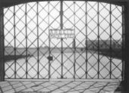
Personal Commentary
Notes:
The appointment of Hitler was the commencement of the a dreadful era.
The Nazis used so much force and brutality during the Holocaust period.
The prisoners were maltreated in the concentration camps.
Registration of prisoners at the concentration camps depicted domination of the Nazis.
Forced labor characterized most of the concentration camps.
Ernst Rohm was the epitome of aggression and brutality during the period.
The Olympiad in Berlin was one of the positives in the face of suffrage.
The Nazi storm troopers were trained to thwart any resistance from the Jews.
The Nazis thrived on propaganda.
11. The burning of Jewish synagogues by the Nazis was outrageous.
12. The Nazi invasion led to the displacement of so many Jews.
(KZ-Gedenkslatte Dachau, n. d).

Slide 8
References
BBC. (n. d). World War 2
Retrieved from
http://www.bbc.co.uk/history/worldwars/wwtwo/
Digital History. (n. d). Overview of World War II. Retrieved from
http://www.digitalhistory.uh.edu/era.cfm?eraid=15&smtid=1
KZ-Gedenkstatte Dachau, (n. d). Stiftung Bayerische Gedenkstatten. Retrieved from
http://www.kz-gedenkstaette-da
chau.de/index-e.html
Pearson Global Schools. (n. d). The causes of World War II in Europe: Hitler’s war. Retrieved from
http://assets.pearsonglobalschools.com/asset_mgr/current/2 01214/HistoryCausesPracticesandEffectsofWarsChapter6.pdf
The History Place. (n. d). Holocaust timeline. Retrieved from
http://www.historyplace.com/worldwar2/holocaust/timeline.html

